Slide 1
Strings
Prepared by
Prof.S.Mahalakshmi
AP/ISE

Slide 2
Basic Terminology
Each programming languages contains a character set that is used to communicate with the computer. The character set include the following:
Alphabet: A B C D E F G H I J K L M N O P Q
R S T U V W X Y Z
Digits: 0 1 2 3 4 5 6 7 8 9
Special characters: + - / * ( ) , . $ = ‘ _ (Blank space)

Slide 3
String: A finite sequences of zero or more Characters is called string.
Length: The number of characters in a string is called length of string.
Empty or Null String: The string with zero characters.
Concatenation: Let S1 and S2 be the strings. The string consisting of the characters of S1 followed by the character S2 is called Concatenation of S1 and S2.
Ex:
‘THE’ ‘END’ = ‘THEEND’
‘THE’ // ‘ ’ // ‘END’ = ‘THE END’

Slide 4
Substring: A string Y is called substring of a string S if there exist string X and Z such that S = X // Y // Z
If X is an empty string, then Y is called an Initial substring of S, and Z is an empty string then Y is called a terminal substring of S.
Ex: ‘BE OR NOT’ is a substring of ‘TO BE OR NOT TO BE’ ‘THE’ is an initial substring of ‘THE END’

Slide 5
STRINGS IN C
In C, the strings are represented as character arrays terminated with the null character \0.
Declaration 1:
#define MAX_SIZE 100 /* maximum size of string */ char s[MAX_SIZE] = {“dog”};
char t[MAX_SIZE] = {“house”};
s[0] | s[1] | s[2] | s[3]
d | o | g | \0
t[0] | t[1] | t[2] | t[3] | t[4] | t[5]
h | o | u | s | e | \0

Slide 6
Declaration 2:
char s[ ] = {“dog”};
char t[ ] = {“house”};
Using these declarations, the C compiler will allocate just enough space to hold each word including the null character.

Slide 7
STORING STRINGS
Strings are stored in three types of structures
Fixed length structures
Variable length structures with fixed maximum
Linked structures

Slide 8
Record Oriented Fixed length storage
Each line of print is viewed as a record, where all have the same length
i.e., where each record accommodates the same number of characters
Suppose the input consists of the program. Using a record oriented, fixed length storage medium, the input data will appear in memory as picture.

Slide 9
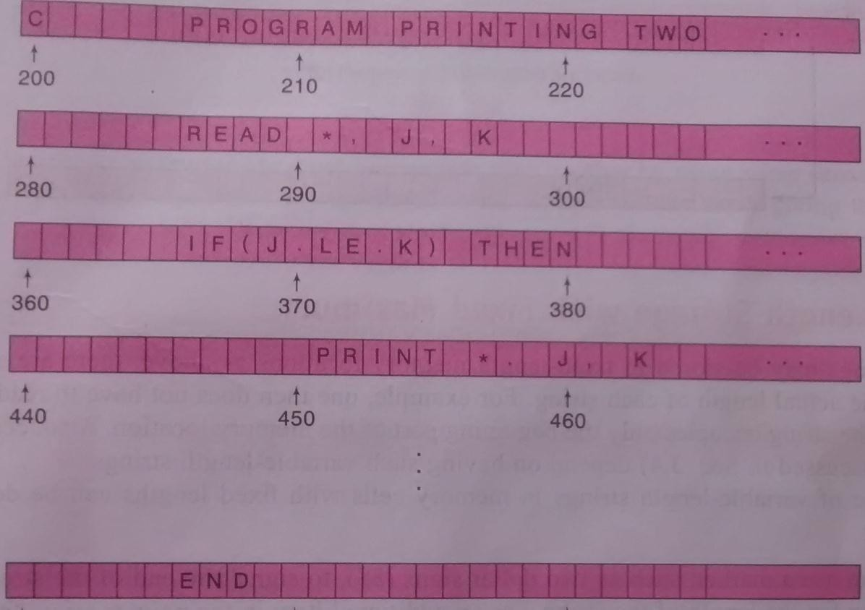

Slide 10
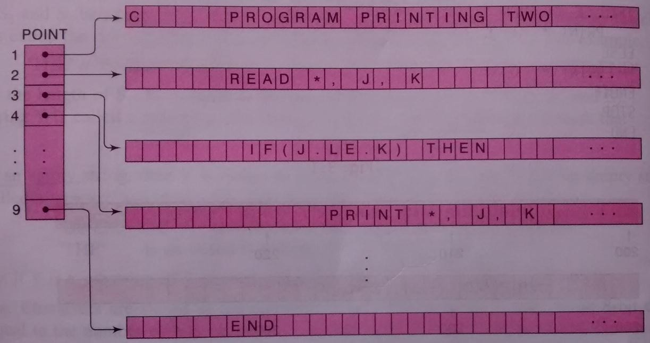
Suppose, if new record needs to be inserted, then it requires that all succeeding records be moved to new memory location.
This disadvantages can be easily remedied as shown in below figure.
Inserting a new record will require only an updating of the array POINT.

Slide 11
The main advantages of this method are
The ease of accessing data from any given record
The ease of updating data in any given record (as long as the length of the new data does not exceed the record length)
The main disadvantages are
Time is wasted reading an entire record if most of the storage consists of inessential blank spaces.
Certain records may require more space than available
When the correction consists of more or fewer characters than the original text, changing a misspelled word requires record to be changed.

Slide 12
Variable length structures with fixed maximum
The storage of variable-length strings in memory cells with fixed lengths can be done in two general ways
One can use a marker(sentinels), such as two dollar signs ($$), to signal the end of the string
One can list the length of the string—as an additional item in the pointer array

Slide 13
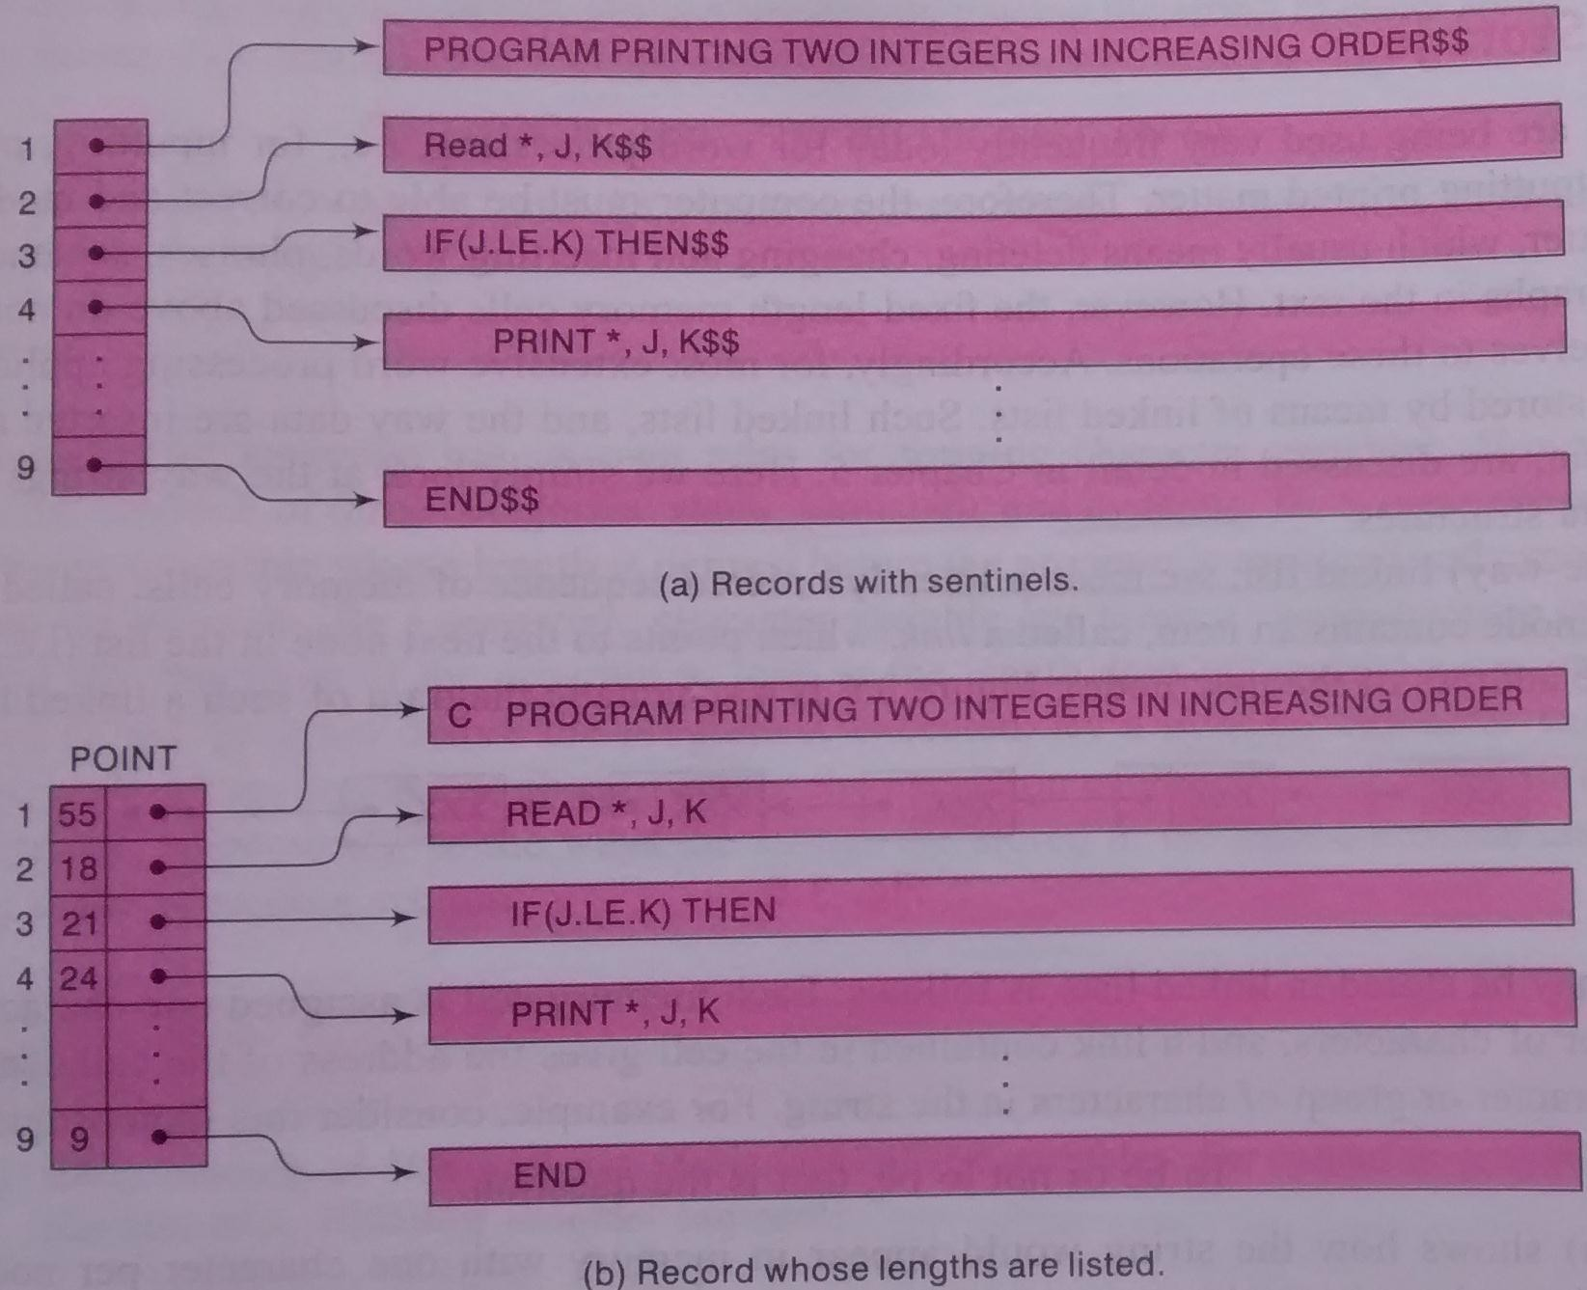

Slide 14
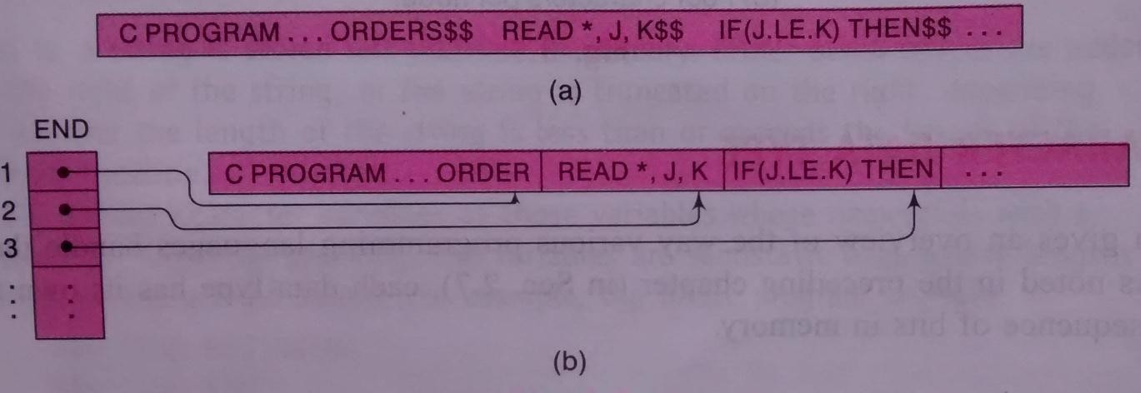
The other method to store strings one after another by using some separation marker, such as the two dollar sign ($$) or by using a pointer giving the location of the string.

Slide 15
Merits and Demerits
These ways of storing strings will save space and are sometimes used in secondary memory when records are relatively permanent and require little changes.
These types of methods of storage are usually inefficient when the strings and their lengths are frequently being changed

Slide 16
Linked Storage
Most extensive word processing applications, strings are stored by means of linked lists.
In a one way linked list, a linearly ordered sequence of memory cells called nodes, where each node contains an item called a link, which points to the next node in the list, i.e., which consists the address of the next node.

Slide 17
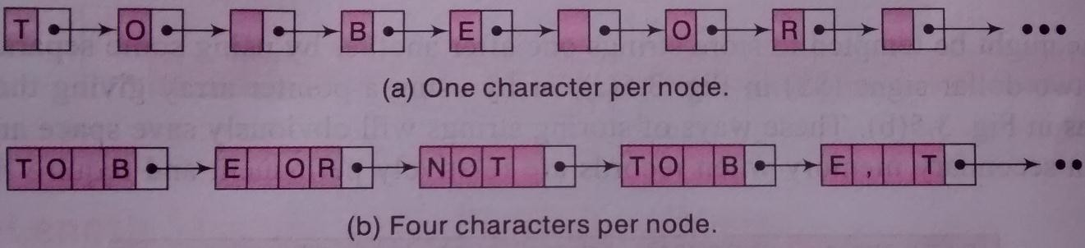
Strings may be Stored in linked list as follows:
Each memory cell is assigned one character or a fixed number of characters and a link contained in the cell gives the address of the cell containing the next character or group of character in the string.
Ex: TO BE OR NOT TO BE

Slide 18
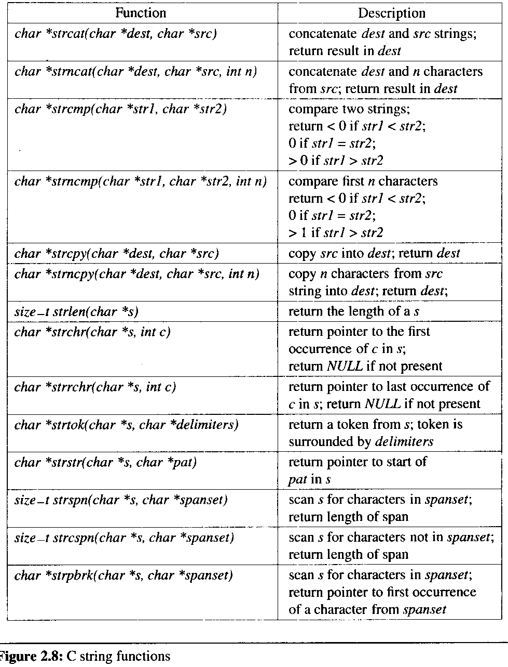
String Functions

Slide 19
PATTERN MATCHING ALGORITHMS
Pattern matching is the problem of deciding whether or not a given string pattern P appears in a string text T.
Condition
The length of P does not exceed the length of T.
Algorithms
Brute Force Pattern Matching
Knuth-Morris-Pratt(KMP) string matching algorithm

Slide 20
Brute Force Pattern Matching Algorithm
we compare a given pattern 'P' with each of the substrings of 'T', moving from left to right, until we get a match or the pattern is not found.
W_{K} = SUBSTRING (T, K, LENGTH (P))
WK →substring of T having the same length as P and beginning with the Kth
character of T.

Slide 21
First compare P, character by character, with the first substring, W1,
If all the characters are the same,
then P = W1 and so P appears in T and INDEX (T, P) = 1.
Suppose it is found that some character of P is not the same as the corresponding character of W1. Then P ≠ W1
Immediately move on to the next substring, W2 That is, compare P with W2. If P ≠ W2 then compare P with W3 and so on.
The process stops, When P is matched with some substring WK and so P appears in T and INDEX(T,P) = K or When all the WK'S with no match and hence P does not appear in T.
The maximum value MAX of the subscript K is equal to LENGTH(T) -LENGTH(P) +1

Slide 22
Algorithm1: (Pattern Matching)
P and T are strings with lengths R and S, and are stored as arrays with one character per element. This algorithm finds the INDEX of P in T.
[Initialize.] Set K: = 1 and MAX: = S - R + 1
Repeat Steps 3 to 5 while K ≤ MAX
Repeat for L = 1 to R: [Tests each character of P]
If P[L] ≠ T[K + L – l], then: Go to Step 5 [End of inner loop.]
4. [Success.] Set INDEX = K, and Exit
5. Set K := K + 1
[End of Step 2 outer loop]
6. [Failure.] Set INDEX = 0
7. Exit

Slide 23
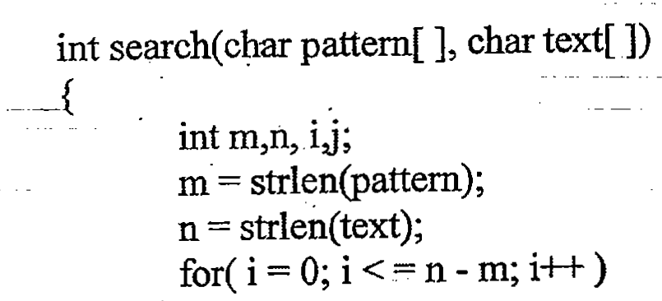
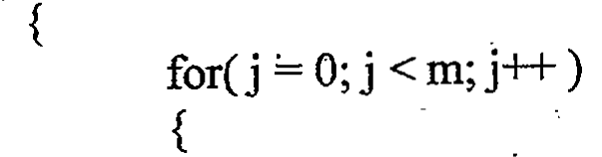

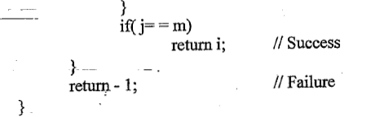

Slide 24
Design, Develop and Implement a Program in C for the following operations on Strings
Read a main String (STR), a Pattern String (PAT) and a Replace String (REP)
Perform Pattern Matching Operation: Find and! Replace all occurrences of PAT in STR with REP if PAT exists in STR.
Report suitable messages in case PAT does not exist in STR
Support the program with functions for each of the above operations.
Don't use Built-in functions.

Slide 25
void main()
{
char str[20], pat[20], repstr[2O], temp[20];
int m, n, i, j, flag, len;
printf("Enter the main string\n");
gets(str);
printf("Enter the pattern string\n");
gets(pat);
printf{"Enter the replace string\n");
gets( repstr);
m = my_strlen(pat);
flag= 0;
i=0;

Slide 26
while( str[i]!= '\0')
{
for(j =0;j <m;j++)
{
if(str[i+j] != pat[j])
break;
} // end of for
if(j==m)
{
j++;
my_strncpy(temp, str, i);
my_strcat(temp, repstr);
i=i +m
len= my_strlen(temp); .
my_ strcat(temp, str+ i);
my_strcpy(str, temp);
i = len;
} // end of if
else
{
i=i+1;
}
} // end of while
if( flag = = 0)
printf( ''Pattern not found in main string\n");
else
{
printf ( "Pattern found %d times in main
string\n'' ,flag);
printf("The resultant string after replacing is
%s\n", str);
} // end of else
} // end of main

Slide 27
Knuth Morris –Pratt (KMP) String Matching Algorithm
The basic idea behind KMP’s algorithm is when we know the structure of the pattern, we can intelligently avoid some number of shifts.
M→ length of original string
N→ length of pattern string
The time complexity of Brute Force or Naïve Algorithm is O(M*N)
The time complexity of KMP Algorithm is O(M+N)

Slide 28
KMP algorithm uses a table which is derived from a particular pattern P but is independent of the text T.
For definiteness, suppose
P = aaba
This algorithm contains the table that is used for the pattern
P = aaba.

Slide 29
The table is obtained as follows.
Let Qi denote the initial substring of P of length i,
hence Q0 = A, Q1 = a, Q2 = a2, Q3 = aab, Q4 = aaba = P (Here Q0 = A is the empty string.)
The rows of the table are labeled by these initial substrings of P, excluding P itself.
The columns of the table are labeled a, b and x, where x represents any character that doesn't appear in the pattern P.
Let f be the function determined by the table; i.e., let f(Qi, t) denote the entry in the table in row Qi and column t (where t is any character). This entry f(Qi, t) is defined to be the largest Q that appears as a terminal substring in the string (Qi t) the concatenation of Qi and t.

Slide 30
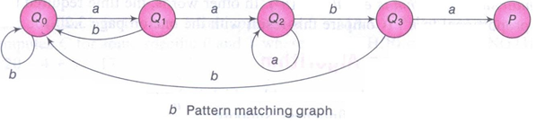
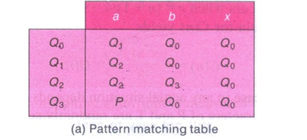
P=aaba

Slide 31
Algorithm: (KMP PATTERN MATCHING)
The pattern matching table F(Q1, T) of a pattern P is in memory, and the input is an N-character string T = T1 T2 T3 …… TN. The algorithm finds the INDEX of P in T.
[Initialize] set K: =1 ans S1 = Q0
Repeat steps 3 to 5 while SK ≠ P and K ≤ N
Read TK
Set SK+1 : = F(SK, TK) [finds next state]
Set K: = K + 1 [Updates counter] [End of step 2 loop]
[Successful ?] If SK = P, then
INDEX = K – LENGTH (P)
Else
INDEX = 0
[End of IF structure]
Exit.

Slide 32
Longest prefix and suffix (LPS /π) table
Example pattern “ABCDABD”
Example pattern “AAABAAA”
J | 1 | 2 | 3 | 4 | 5 | 6 | 7
Pattern | A | B | C | D | A | B | D
lps | 0 | 0 | 0 | 0 | 1 | 2 | 0
J | 1 | 2 | 3 | 4 | 5 | 6 | 7
Pattern | A | A | A | B | A | A | A
lps | 0 | 1 | 2 | 0 | 1 | 2 | 3

Slide 33
Pattern "ABABABCA”
Pattern “ AABAACAABAA"
Pos | 1 | 2 | 3 | 4 | 5 | 6 | 7 | 8
Pattern | A | B | A | B | A | B | C | A
lps | 0 | 0 | 1 | 2 | 3 | 4 | 0 | 1
Pos | 1 | 2 | 3 | 4 | 5 | 6 | 7 | 8 | 9 | 10 | 11
pat | A | A | B | A | A | C | A | A | B | A | A
lps | 0 | 1 | 0 | 1 | 2 | 0 | 1 | 2 | 3 | 4 | 5

Slide 34
KMP Pattern Matching
Rule 1: If Mismatch occurs at the first position of pattern, then shift pattern by one position.
Rule 2: If a partial match of length len is found and table[len] = 0, we may skip ahead len
characters-and-continue matching
Rule 3: If a partial match of length len is found and table[len ] > = 1, we may skip ahead
len- table[len] characters and continue matching after table[len -1]characters.

Slide 35
EG
Let the string be, “ABCABCDABABCDABCDABDE“
pattern''ABCDABD'‘
Pos | 1 | 2 | 3 | 4 | 5 | 6 | 7
pat | A | B | C | D | A | B | D
lps | 0 | 0 | 0 | 0 | 1 | 2 | 0

